Slide 1
IoT based Smart Assistance (Spoon) for Parkinson Patients IOT, ROBOTICS, IMAGE DETECTION
VIVEK RAJ - 169105217
WASIM -169105218
UNDER ANUBHA PARASHAR MAAM

Slide 2
Contents
1. Contents
2. Introduction
3. Literature review
4. Problem statement
5. Objectives
6. Propose solution
7. Methodology (also include activity diagram
8. Explain methodology by points wise
9. Result Analysis
10. Improved Result
11. Conclusion
12. Future Work
13. Time line

Slide 3
Introduction
Robotics is a broad topic which can include mechanical devices, sometimes resembling humans, or software entities. Generally such ‘robots’ can be set to perform one or more specific tasks.
IoT is not a technology its an ecosystem of all kind of technology in a connected world for efficient use of resources, easing human work and reducing losses because of human errors. The reason why IoT is trending is because of the ability of this technology to affect lives of individuals at the ground level
With today’s technology, people with Parkinson’s disease can, with a device on their wrist, be able to draw pictures. And such stabilizing techniques have been used to make stabilizing spoons to assist people who need assistance during their eating process.
But by using Robotics, we aim to make the solution much more functional.

Slide 4
Domain
Domain of the topic selected is Robotics and IOT. We selected this project because we wanted to help people with impaired motor skills by assisting them in their day to day struggle.
There is no cure for Parkinson’s disease and having to suffer from it for the rest of their life is troublesome. We aim to provide them an additional hand which will aid by feeding them. This will done by detecting where the patient's mouth is and maneuvering to that exact point.

Slide 5
Literature Review
The project presents a background on the importance of robotics in our daily life, the importance of creativity and entrepreneurship in business, and the different technologies used in designing a mechanical arm.
References:
The Stabilizing Spoon: Self-stabilizing utensil to help people with impaired motor skills, by JOHAN ABRAHAMSSON and JOHAN DANMO.
Parkinson’s Tremor Stabilization Spoon by Gifty E B , Vandana M.

Slide 6
Problem Statement
The aim of the project is to make the machine more efficient whit high stability so that the food doesn’t spill.
It is necessary for it be easily usable as it will operated by patients or nurses.
We need to make a machine that can feed the said patient with no efforts needed that will pick the food and spoon feed it to the patient. With a low budget, the goal is to make a highly efficient prototype that consists mainly of a microcontroller and servo motors.
We need to learn all about Arduino or Raspberry Pi in order proceed with this project

Slide 7
Objectives
The objective of this project is to make a machine that can feed the said patient with no efforts needed that will pick the food and spoon feed it to the patient. With a low budget, the goal is to make a highly efficient prototype that consists mainly of a microcontroller and servo motors.
We are aiming to design a machine that is much more functional and easier for the patient to use.

Slide 8
Proposed Solution
For solving this problem we are using Robotics and IOT to build a robotic arm, that operates using servo motors and stepper motors. A robotic arm will be needed, that should be made up of light material.
This arm has 4 degrees of freedom which could rotate in any direction and move to any point in the space in front of it.
The robotic arm should reach out to a bowl of food, pick the food up, and and deliver it to the patient’s mouth.
It will have an operating space in which the person’s mouth should be present.

Slide 9
About Existing Solution
The technology that exist today for assisting Parkinson’s patients is self stabilizing spoon, that can be held in one hand and use it as normal spoon.
The spoon stabilizes itself when the patient shakes, thus making it easy for the person to eat food .
The pros and cons of existing technique is
Pros | Cons
It helps functionally challenged people to eat with more ease | The person has to hold the spoon in his hands that is still inefficient.

Slide 10
PROCESS FLOW:
Assemble the robotic arm
Make connections with hc-05, servo motors and Arduino
Integrate it into a working model
Start
Test
Refine the code for better performance
Stop
Develop Bluetooth Mobile app
Accurate
Results
Inaccurate Results

Slide 11
Facilities required for proposed work:
Raspberry Pi
Servo Motors
Stepper motor
Robotic arm
Breadboard
Jumper Cables
Other modules like Bluetooth module, WIFI module etc

Slide 12
Methodology:
Deciding on all the small tasks the machine should be able to perform.
To avoid change in the number of components or the type of components, the working of the robot was divided into a group of smaller functions.
The number, sizes, and type of components were carefully decided upon, so that minimum changes happen in requirements, while building the model
Obtaining all the hardware required for the project.
Some of the components that were needed for our project were obtained from the IOT lab of our college.
The rest of the components that were unavailable were bought from online stores and hardware shops

Slide 13
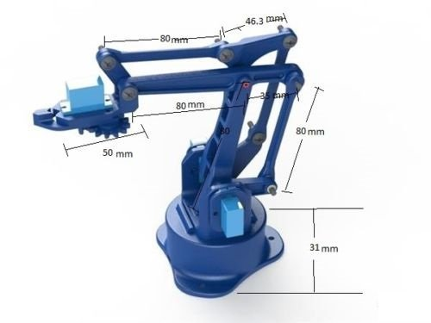
Methodology:
Building the working model with all the motors attached.
A simple model was initially made to test the strength and the functions of a servo motor.
Then a model of a robotic arm was selected, and the necessary changes were decided upon, that will be designed.

Slide 14
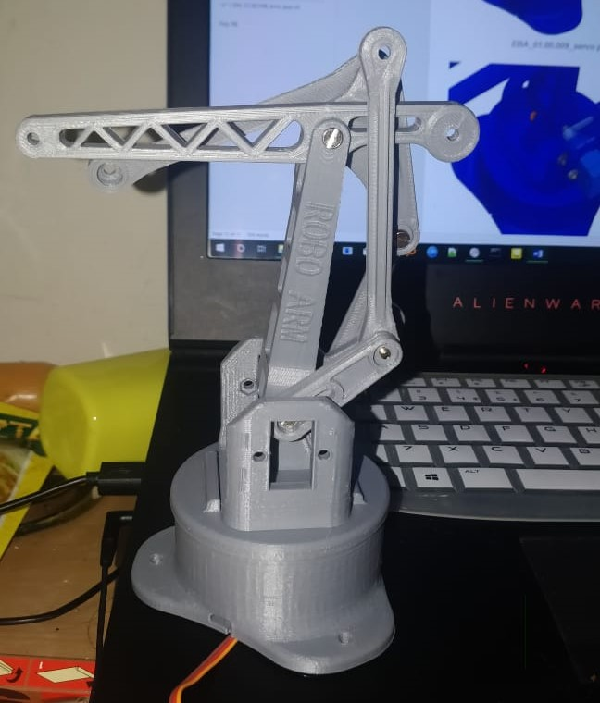
Methodology:
The pre- selected 3D model was bought from an online store, and the robotic arm was assembled.

Slide 15
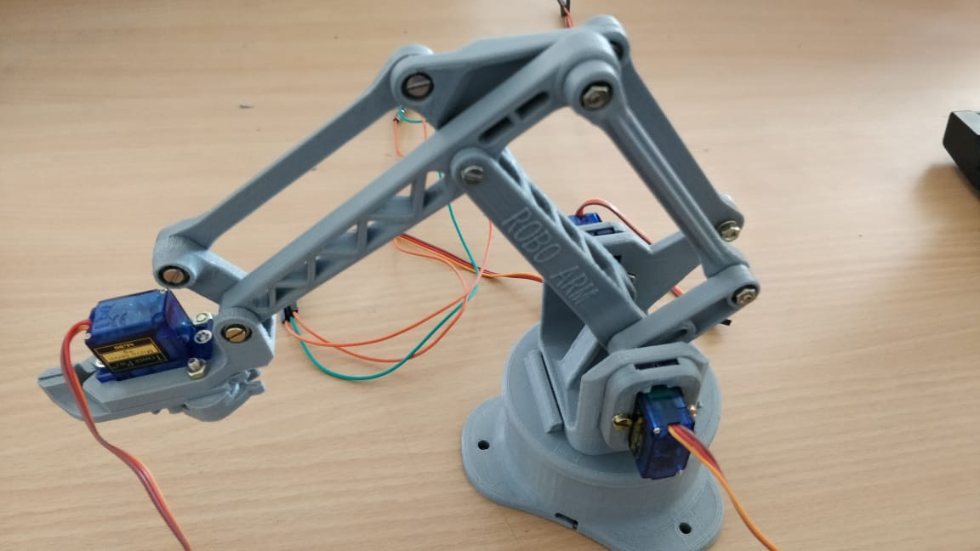
Methodology:
The required number of servo motors were attached to the model, so that the robot can perform every kind of movement.

Slide 16
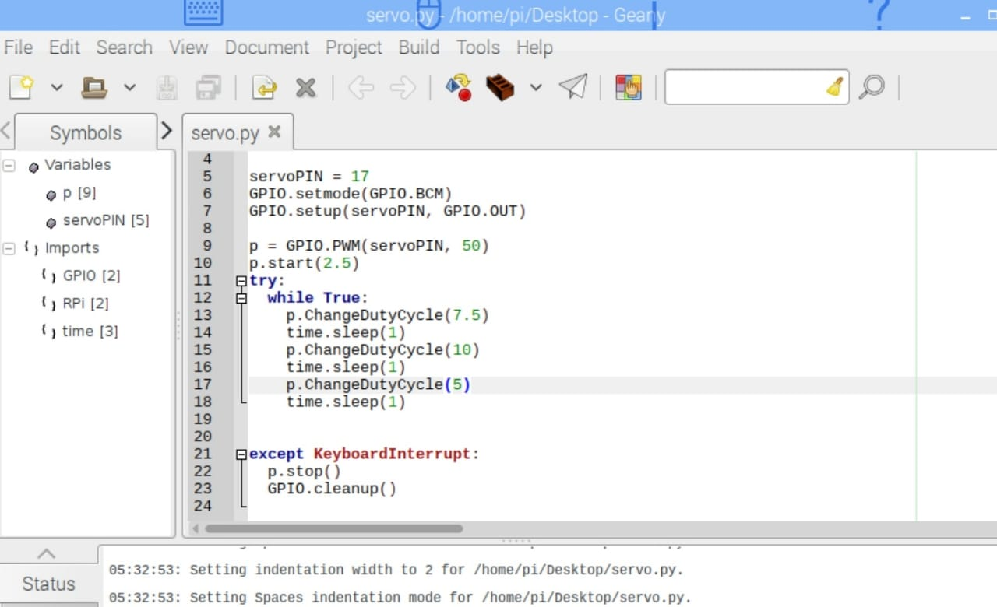
Methodology:
Coding the different small tasks on different motors one by one .
The way of connecting a raspberry pi to a phone was established so that the model can be controlled wirelessly.

Slide 17
Methodology:
The further work to be done is:
A 3D design of the front end the robotic model is to be finished and get it printed from a 3D printer.
The servo motors are to be coded in such a way that they can work simultaneously.
Coding the machine to pick the food from the bowl and slowly feed it to the person.

Slide 18
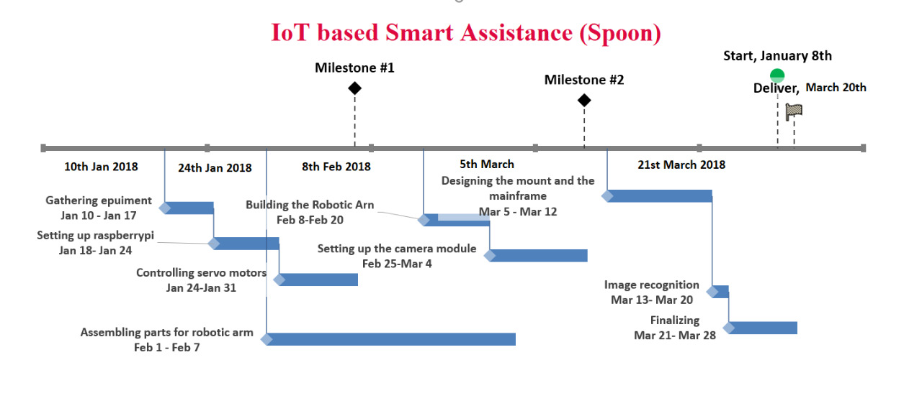
Project Timeline

Slide 19
Future Scope
The further work to be done is:
Making it commercially viable and cheap enough.
Designing an exterior shell for the robotic arm.
Making it more compact and easy to store
Making it chargeable.

Slide 20
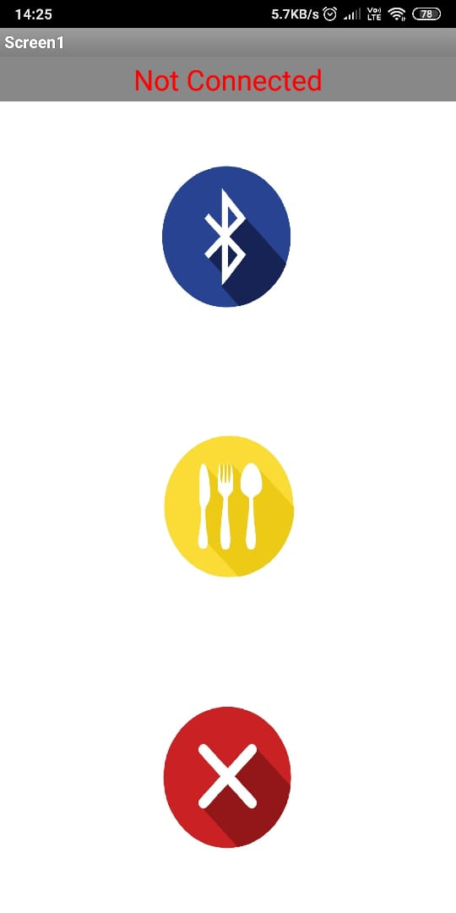
Result
App Screenshots
The robotic arm model was successfully implemented which was able to pick up food from the tray and direct it towards the mouth of the user.
The Bluetooth app for connecting to the arm, controlling and terminating the process was also developed.

Slide 21
Conclusion
The objectives of this project has been achieved which was developing the hardware and software for an user controlled robotic arm. From observation that has been made, it clearly shows that its movement is precise, accurate, and is easy to control and user friendly to use. The robotic arm has been developed successfully as the movement of the robot can be controlled precisely. This robotic arm control method is expected to overcome the problem such as placing or picking edibles towards the user in a very fast and easy manner.

Slide 22
Thank You

